Slide 1

Spam Detection AI Model

Slide 2
agenda
System Architecture
Data Collection and Preprocessing
Feature Extraction
Model Training and Evaluation
Evaluation Metrics
Deployment and Real-time Filtering
Challenges and Considerations
Conclusion

Slide 3
Overview
Spam detection in emails refers to the process of identifying unwanted or unsolicited messages (spam). These messages often contain advertisements, phishing attempts, or malware. The goal of an AI-based spam detection system is to automatically classify these messages and filter them out, improving user experience and security.
An AI-based spam detection model typically uses machine learning algorithms, particularly those in natural language processing (NLP), to classify incoming messages as either spam or non-spam (ham). This process involves preprocessing email data, extracting features from the text, training a model, and evaluating its performance.
This document outlines how to build and deploy an AI spam detection model for email messages, with code examples in Python for each step.

Slide 4

1. System Architecture
The Spam Detection AI system follows a typical architecture for text classification tasks. The system is composed of three main components:
Data Collection and Preprocessing: The dataset is loaded, cleaned, and preprocessed to convert raw SMS data into a suitable format for analysis.
Feature Extraction: Text data is transformed into numerical feature vectors using a vectorization technique such as CountVectorizer.
Model Training and Prediction: A Naive Bayes model is trained on the feature vectors to classify the messages as spam or ham. The model is evaluated on a test set, and predictions can be made in real-time.

Slide 5
2. Data Collection and Preprocessing
The dataset used for training the model is sourced from the UCI Machine Learning Repository, specifically the SMSSpamCollection dataset. This dataset contains a collection of SMS messages labeled as either "spam" or "ham."
The data is loaded from a zip file available at the following URL: https://archive.ics.uci.edu/ml/machine-learning-databases/00228/smsspamcollection.zip
The dataset is then read into a pandas DataFrame, with the text messages and their corresponding labels (spam/ham).
Labels are converted into binary values:
'spam' → 1
'ham' → 0

Slide 6
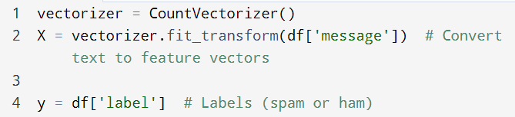
3. Feature Extraction
To make text data understandable for machine learning models, it needs to be transformed into numerical features. The CountVectorizer is used to convert the messages into a bag-of-words representation, which is then converted into feature vectors. Each word is treated as a feature, and the vectorizer counts the frequency of each word in the message.

Slide 7
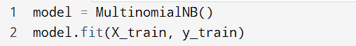
4. Model Training and Evaluation
The model used for classification is the Multinomial Naive Bayes (MNB) classifier, which is a popular algorithm for text classification tasks.
Training: The dataset is split into training and testing sets using train_test_split. The training set is used to train the Naive Bayes model.
Evaluation: After training, the model is tested on the unseen test data, and the performance is evaluated using metrics like accuracy and classification report.

Slide 8
5. Evaluation Metrics
To assess the performance of the spam detection model, we use several metrics:
Accuracy: The percentage of correct predictions made by the model.
Precision: The proportion of true positives (spam messages) among all predicted spam messages.
Recall: The proportion of true positives (spam messages) among all actual spam messages.
F1-Score: The harmonic mean of precision and recall, providing a balanced evaluation.

Slide 9
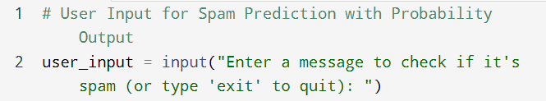
6. Deployment and Real-time Filtering
Once the model is trained and evaluated, it can be deployed for real-time spam classification. Users can input text (email or SMS), and the model will predict whether the message is spam or ham, along with the probability.
In a production environment, this could be integrated into email servers or messaging platforms to filter spam in real-time.

Slide 10
7. Challenges and Considerations
Data Quality: The quality and size of the dataset directly impact the model's performance. Smaller or noisy datasets may lead to overfitting or poor generalization.
Model Overfitting: Ensuring the model generalizes well on unseen data by tuning hyperparameters and using techniques like cross-validation.
Real-time Latency: For real-time spam filtering, the model must make predictions quickly without significant delays.
Handling New Spam Techniques: Spam messages evolve over time, so the model must be periodically retrained with new data to handle emerging spam techniques.

Slide 11
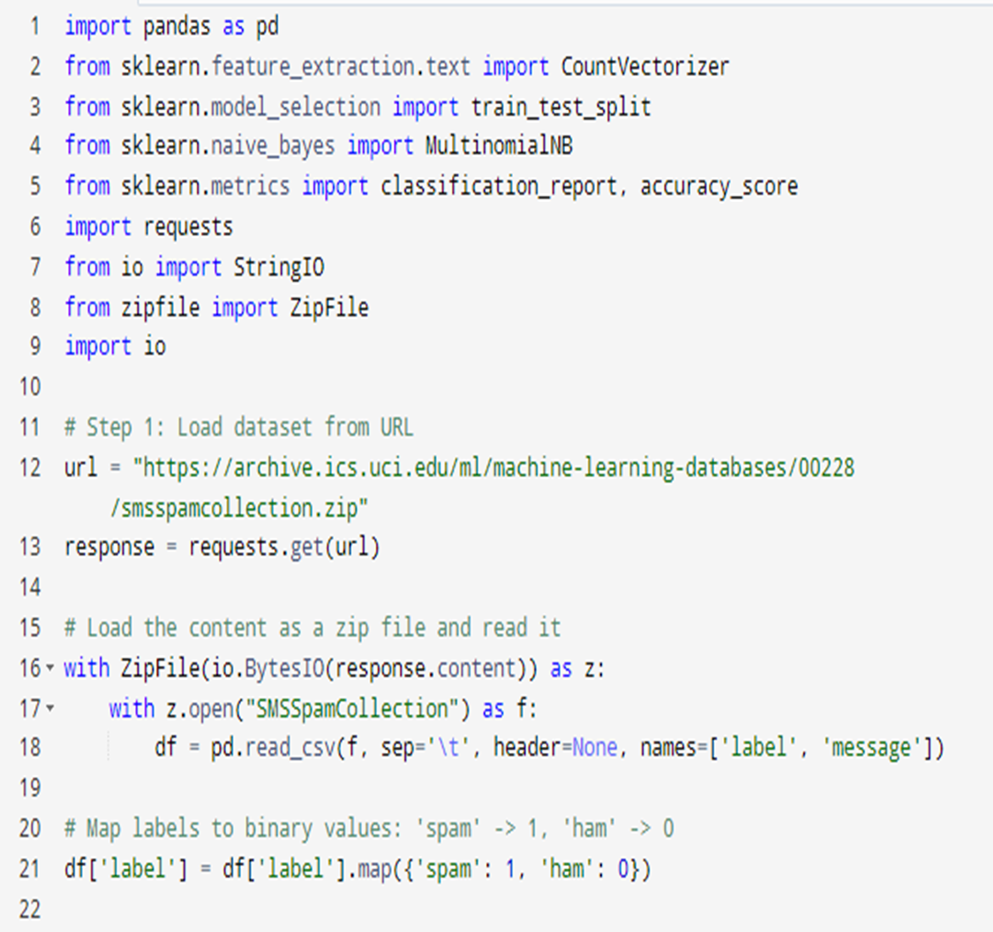

Slide 12
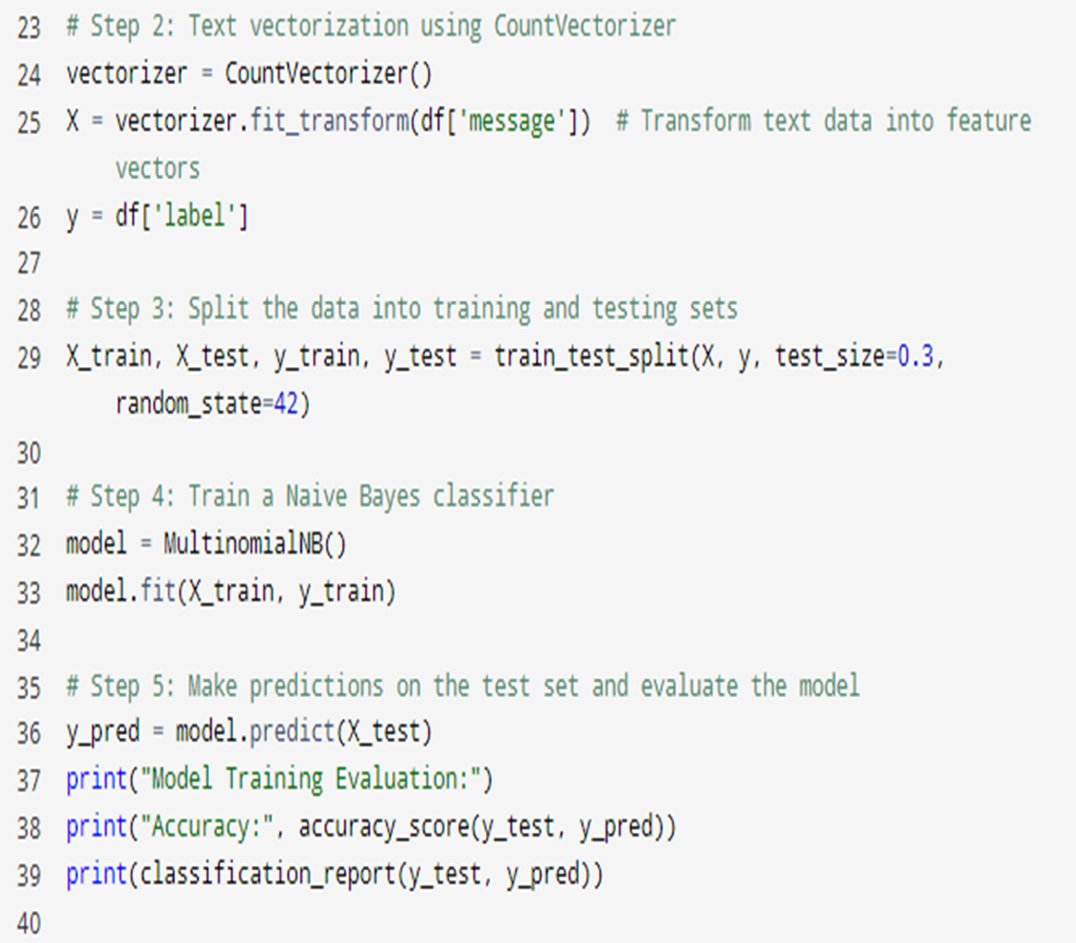

Slide 13
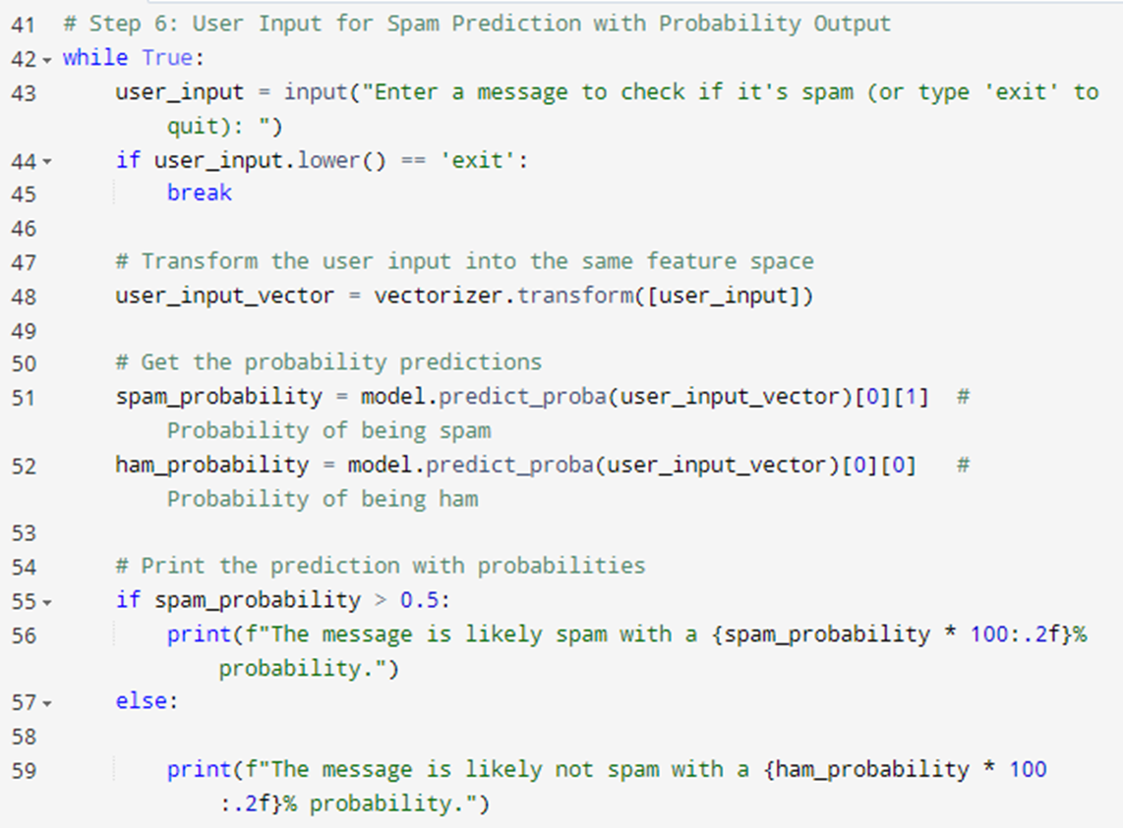

Slide 14
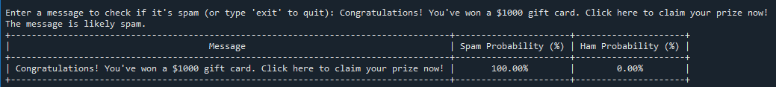
Spam Example:
Message: Congratulations! You've won a $1000 gift card. Click here to claim your prize now!
Reason: This message is a typical spam message because it contains an unsolicited offer, often linked to phishing or other scams. It aims to get the user to click on a link to steal personal information or install malware.
Output:

Slide 15
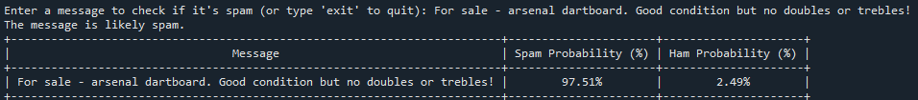
Spam Example:
Message: For sale - arsenal dartboard. Good condition but no doubles or trebles!
Why it's spam: Promotional Nature: The use of the phrase "For sale"
suggests an advertisement or offer to sell something.
Pattern Recognition: The classifier has learned that similar phrases (like "For sale") are often associated with spam, especially in the context of unsolicited messages about products or services.
Output:

Slide 16
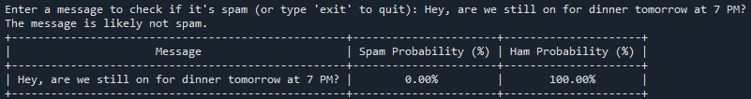
Non-Spam (Ham) Example:
Message: "Hey, are we still on for dinner tomorrow at 7 PM?"
Reason: This message is non-spam (ham) because it is a regular, personal communication between individuals. It is legitimate and not intended for mass distribution or to deceive the recipient.
Output:

Slide 17
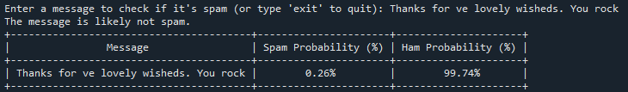
Non-Spam (Ham) Example:
Message: Thanks for ve lovely wisheds. You rock
Why it's non-spam: The message "Thanks for ve lovely wisheds. You rock" is classified as ham because it has a personal and friendly tone, lacks any promotional language or unsolicited offers, and appears to be part of a genuine, positive interaction
Output:

Slide 18
Conclusion
The Spam Detection AI model developed here demonstrates the ability to classify SMS messages as either spam or ham using machine learning. The process involves preprocessing text data, extracting features using CountVectorizer, and training a Naive Bayes classifier. The system can be deployed for real-time filtering and integrated into email or SMS services. While the model performs well, addressing challenges such as imbalanced datasets and model retraining will improve long-term performance and scalability.

Slide 19
Ahmed emad aboubakr ramadan mena Yousef assem Khaled menna ramadan malak ashraf

Slide 20
thanks

